Slide 1
Benchmarking report
Brandon drontle

Slide 4
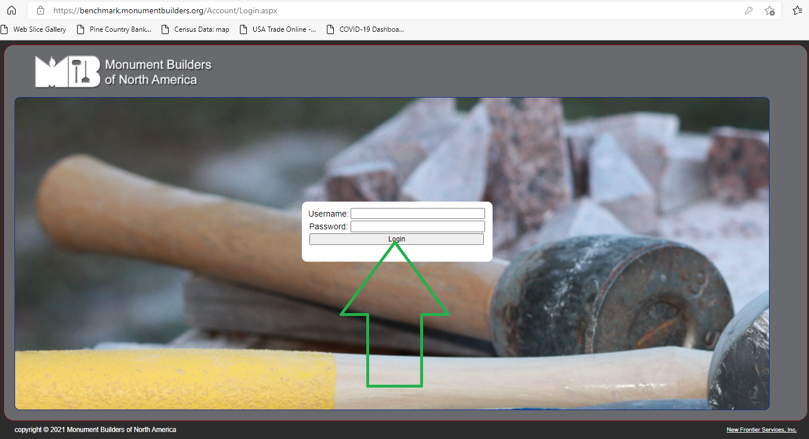

Slide 5
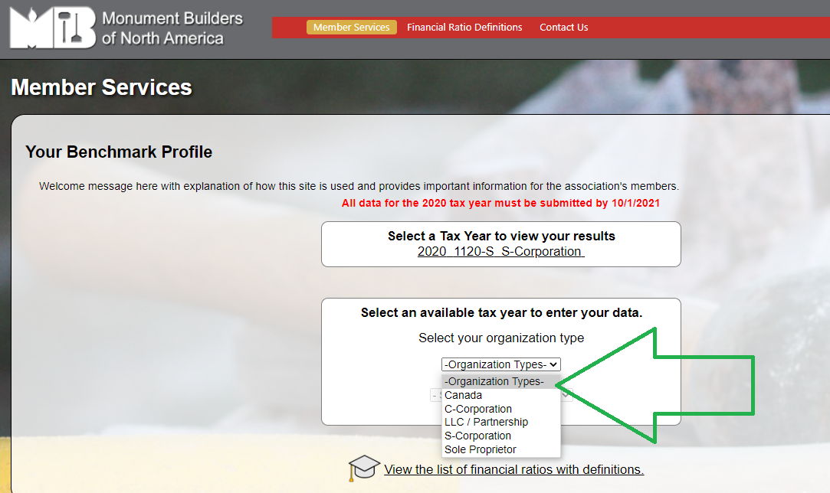

Slide 6
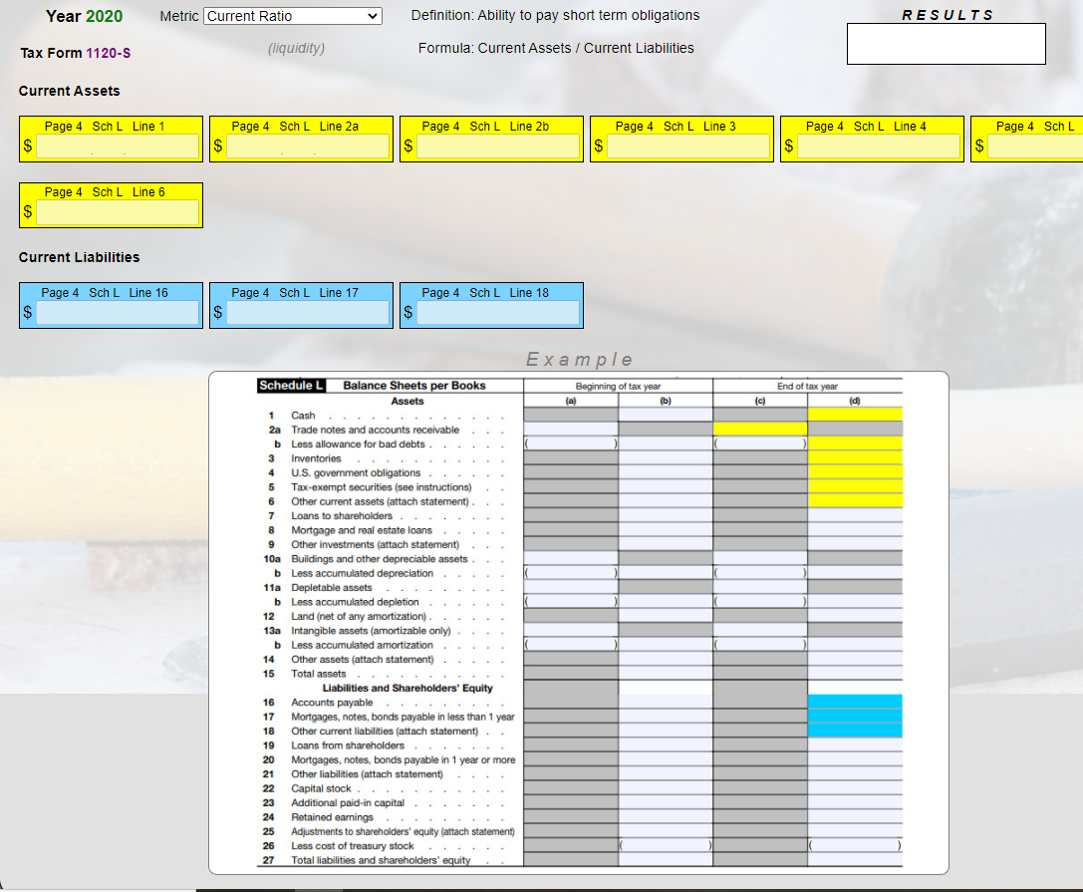

Slide 8
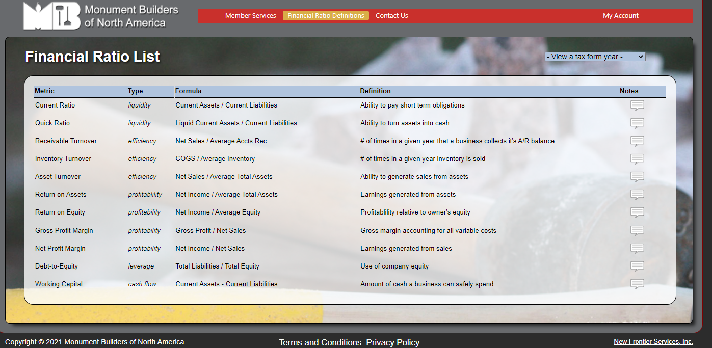

Slide 9
Benefits:
It’s completely free!
Unique & relevant
It’s safe!
Customizable
Good for business!

